Slide 1
Prediction of Hate Speech and Offensive Language in Tweets Text
Final Project Presentation
Presented By: <Student Name> <(student ID)>
Supervisor: <Supervisor Name>
<University Name>

Slide 2
Implementation
Results
Future Work
Conclusion
References
Outline

Slide 3
Implementation
1.

Slide 4
Implementation (Down Sampling)
Initial Class Distribution.
Class A (Hate Speech): 1430
Class B (Offensive Language): 19190
Class C (Neutral): 4163
Down sampling of data due to class misbalancing.
Class Distribution after Down sampling
Class A (Hate Speech): 1200
Class B (Offensive Language): 1200
Class C (Neutral): 1200

Slide 5
Implementation (Data Cleaning)
Data Cleaning
Remove Numeric values, URL’s
Remove Special Character
Remove Emojis
Lower Case Conversion
Stemming And Lemmatization
Feature Extraction
TF-IDF

Slide 6
Implementation (Feature Extraction)
Extract Feature from Text
Using TF-IDF Count Vectorizer
Set all words as Features
Got the 11079 features from text
Final dataset of shape 2520 * 11079

Slide 7
SVM model
Train SVM model on text Features
Initialize SVM from scikit-learn.
Use the default value of all hyper parameters.
Only tuned the Kernel parameter of SVM.

Slide 8
Chainer Classfier
Initialize Chainer Classifier
Pass the loaded SVM model to chainer classifier.
Use the chainer model for multi label classification.
Use all the hyper parameters of chainer classifier with default values.
Set the Linear Kernel of SVM.

Slide 9
Powerset Classifier
Initialize Powerset Classifier
Pass the loaded SVM model to powerset classifier.
Use the powerset model for multi label classification.
Use all the hyper parameters of chainer classifier with default values.
Set the Sigmoid kernel of SVM.

Slide 10
Results and Discussion
2.

Slide 11
SVM Chainer Results
Train the SVM Chainer with 2520 training samples.
Test the model with 980 test samples.
Got the 0.8083% test accuracy score.
Got 0.81% precision and recall score also.
Also got 0.8042% f1-score of SVM chainer classifier.

Slide 12
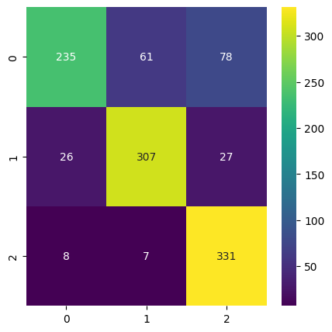
SVM Chainer Results
Complete Classification Report and Confusion matrix
Classification Report for SVM Chainer Classifier
 | precision | recall | f1-score | support
Hate-speech | 0.87 | 0.63 | 0.73 | 374
Offensive | 0.82 | 0.85 | 0.84 | 360
Neutral | 0.76 | 0.96 | 0.85 | 346
accuracy |  |  | 0.81 | 1080
macro avg | 0.82 | 0.81 | 0.80 | 1080
weighted avg | 0.82 | 0.81 | 0.80 | 1080
Accuracy Score (Training): 0.8316 Accuracy Score (Testing): 0.8083

Slide 13
SVM Powerset Results
Train the SVM powerset with 2520 training samples.
Test the model with 980 test samples.
Got the 0.8018% test accuracy score.
Got 0.80% precision and recall score also.
Also got 0.8032% f1-score of SVM Powerset classifier.

Slide 14
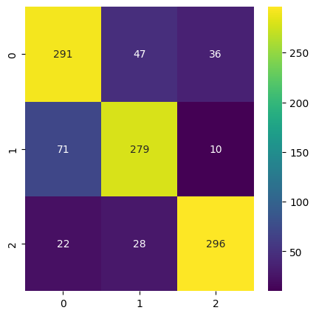
SVM Powerset Results
Complete Classification Report and Confusion matrix
Classification Report for SVM Chainer Classifier
 | precision | recall | f1-score | support
Hate-speech | 0.76 | 0.78 | 0.77 | 374
Offensive | 0.79 | 0.78 | 0.78 | 360
Neutral | 0.87 | 0.86 | 0.86 | 346
accuracy |  |  | 0.80 | 1080
macro avg | 0.80 | 0.80 | 0.80 | 1080
weighted avg | 0.80 | 0.80 | 0.80 | 1080
Accuracy Score (Training): 0.8316 Accuracy Score (Testing): 0.8018

Slide 15
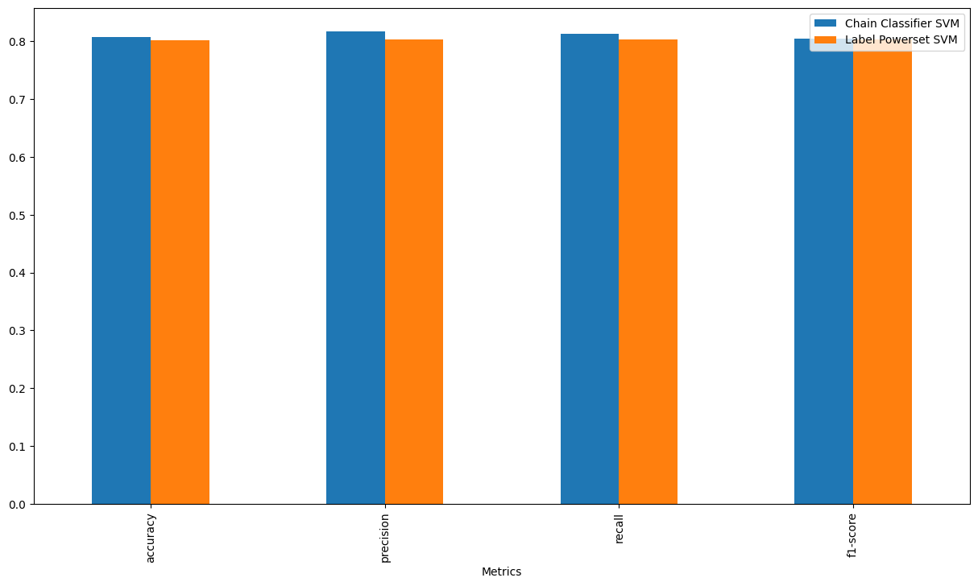
Comparison
Metrics | SVM Chainer | SVM Powerset
accuracy | 0.8083 | 0.8018
precision | 0.8171 | 0.8038
recall | 0.8125 | 0.8028
f1-score | 0.8042 | 0.8032

Slide 16
Future Work
3.

Slide 17
Future Work
Use different techniques of features extraction.
Train model with different combination of features set (features Selection)
Use Ensemble Learning Model.
Extract Features with Deep learning models and classify them with ML models.
Transfer Learning technique with deep learning models.

Slide 18
Conclusion
4.

Slide 19
Conclusion
Use different Machine Learning Models.
Evaluate all the models using the following measures:
Accuracy
Precision
Recall
F1-Score
Compare the results of both models.
Got the highest accuracy (~0.81%) with SVM Chainer.
Accuracy show that model is robust enough to make prediction on live data

Slide 20
Thank You

